Slide 1
Analysis of movie blockbusters
By Amen mekonnen
DATA 110: Data Visualization & Communication

Slide 2
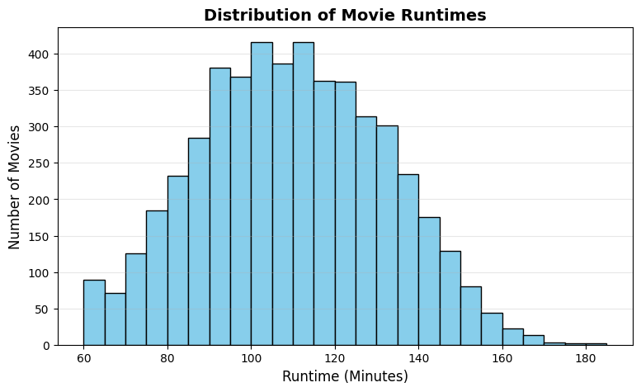
Do movie runtimes vary wildly, or do studios stick to a strict formula?
1

Slide 3
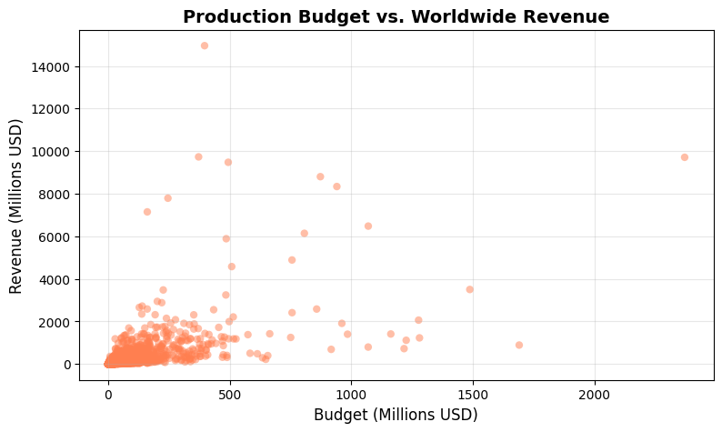
Does spending more money on a budget guarantee box office success?
2

Slide 4
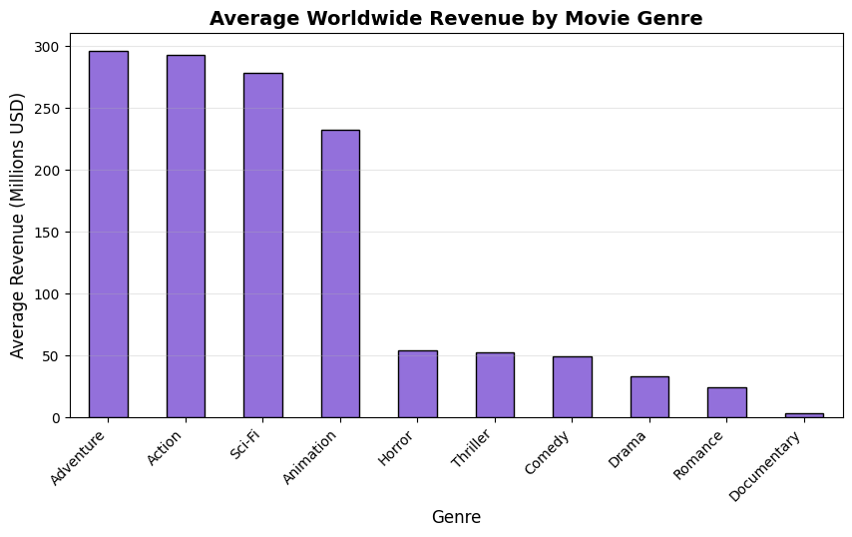
Which movie genres dominate global box office earnings?
3

Slide 5

Want to make a Blockbuster?
1
3
4
Duration
Investment
Genre
Stick to 90–120 minutes to align with standard viewer expectations
Higher budgets yield higher revenue ceilings, but require careful risk management.
Action, Adventure, and Sci-Fi yield the highest average financial returns.

